Slide 1
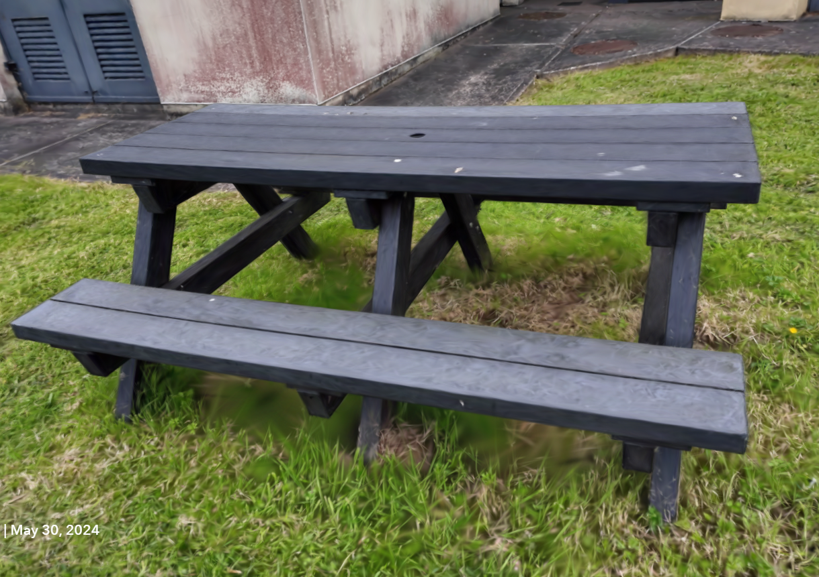
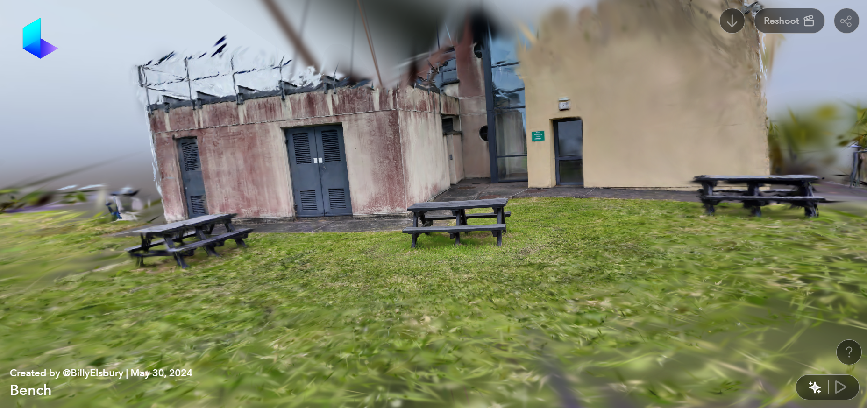
Capturing, Editing and Merging Gaussian Splats to Create Novel 3D Environments

Slide 2
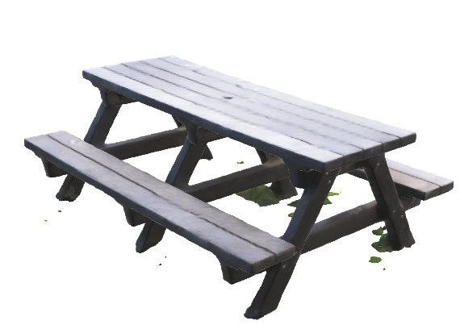
Objectives and Research Area
Objectives:
To create, edit, and merge Gaussian Splats to develop novel and visually interesting 3D environments for game development and beyond.
Compare Gaussian Splatting with other emerging methods, such as Neural Radiance Fields (NeRF) and traditional photogrammetry.
Examine the limitations of Gaussian Splats in 3D environments.
Explore available tools for editing, enhancing, and extending the use of Gaussian Splats.
Research Area: Computer Graphics, Photogrammetry, 3D Rendering, and Game Development, with a specific focus on the editing, merging, and rendering of point cloud data using game engines.
Research Question: How can Gaussian Splats be edited and merged to create novel and visually impressive 3D environments for use in game development and beyond?

Slide 3
What is a Gaussian Splat
Capturing Multiple Views: Taking several images or a video of an object or scene from different angles.
Key Point Detection: Specialised algorithms identify distinct, recognizable features within the images that can be consistently detected across different perspectives.
Camera Position Estimation: Using the identified features, calculate the relative position and orientation of the camera for each image, determining how the scene was captured from different viewpoints.
Triangulation: With the camera positions known, a triangulation process calculates the 3D coordinates of the features by tracing lines from the camera positions and finding where they intersect in space.
Point Cloud Generation: The triangulation results in a sparse point cloud, which provides a basic 3D structure of the scene by representing key features as individual points. The process can then be expanded for a denser point cloud
Surface Reconstruction: Gaussian functions are applied to the point cloud data to reconstruct the surface of the object or scene.

